Slide 1

CYBERCRIME
A comprehensive introduction

Slide 2

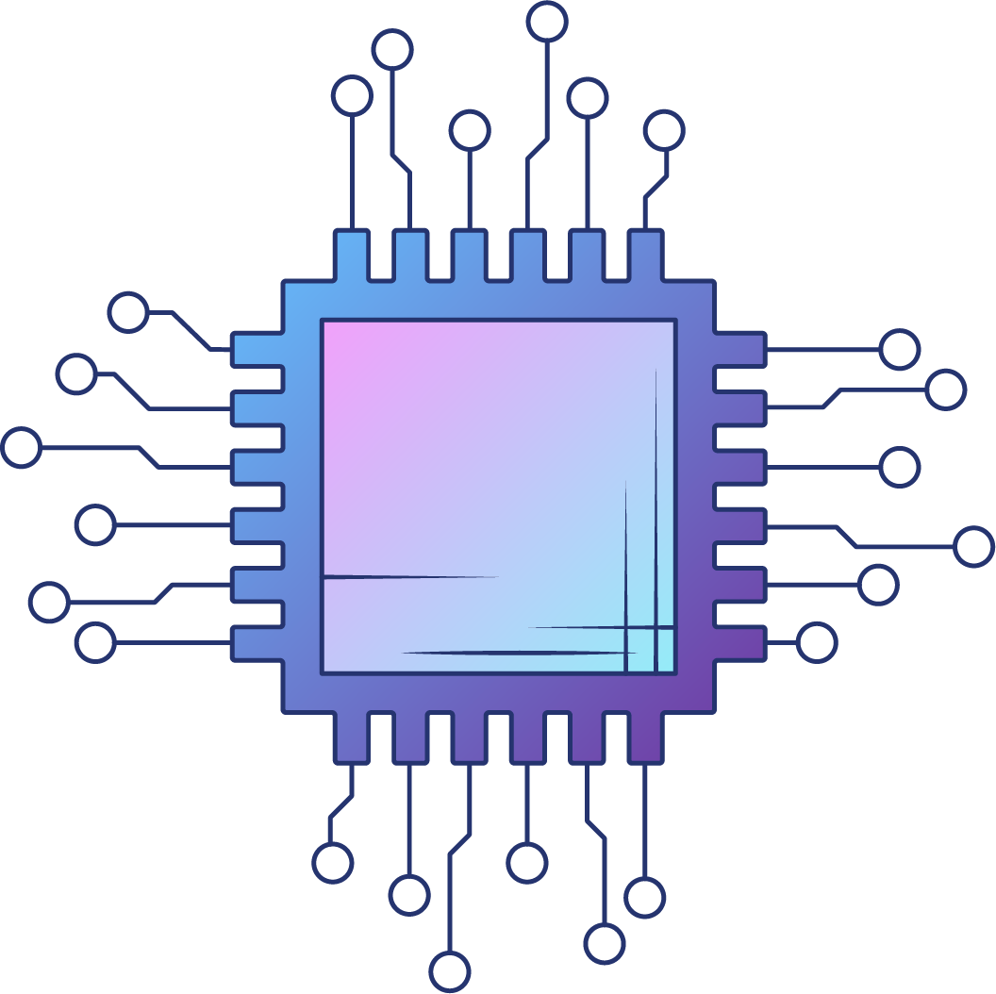
INTRODUCTION TO DIGITAL SOCIETY
Digital innovations have reshaped every aspect of human endeavour and also have a huge impact on private and social life of users
The society that renders itself successful to translate its affairs to digital by adoption of information and communication technology at home and workplace is referred as digital society
To address the various influences of digital innovations, digital societies mainly emphasize on:
Regulation and Policy Development
Legally Compliant services and tools
Creation of common digital culture
Community policing and ICT-enhanced disaster management

Slide 3
DIGITAL SECURITY (DATA AND NETWORK)
ASPECTS
E –Commerce, Online Banking, VOIP, Internet Relay Chat
SECURITY
THREATS
Interception: Gain of unauthorized access
Interruption: Alteration of data by the unauthorized
Modification: Changing / tampering of data
Fabrication: Generation of new and false data
SECURITY
ATTACK
Passive Attack: Making use of information from the system without using system resources
Active Attack: Actively altering System resources and affecting data of a user
SECURITY
SERVICES
Authentication 4. Integrity
Authorization 5. Non-repudiation
Confidentiality

Slide 4


01
TYPES OF CYBER CRIME

Slide 5


CYBER CRIMES
Cybercrime refers to the wrong use of computers, the internet, or electronic media.
Cybercrimes range from the theft of personal information such as bank accounts to the illegal distribution of content such as music and other material protected by copyright.

Slide 6
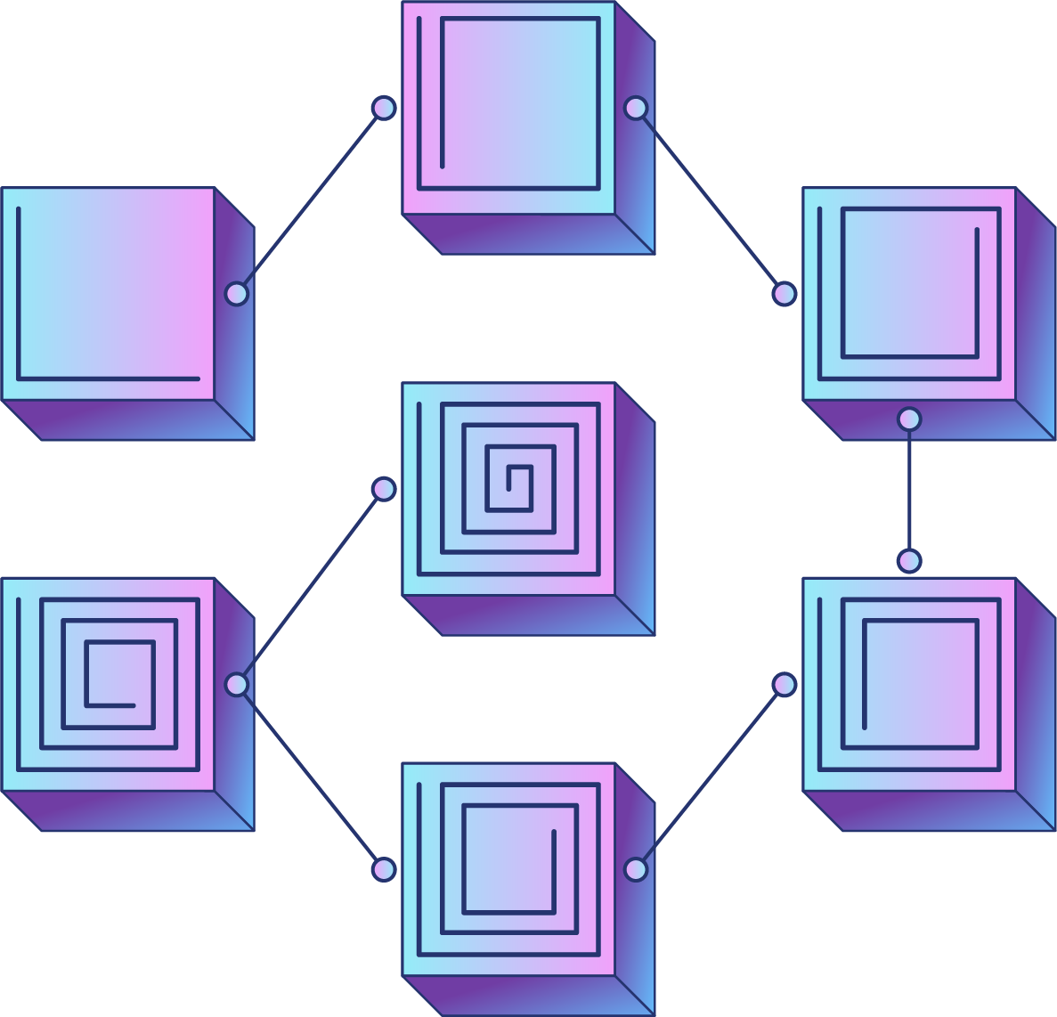


TYPES OF CYBER CRIME
AI-Powered Attacks: AI-powered attacks involve using artificial intelligence and machine learning to automate and enhance cyberattacks. For example, AI can be used to identify vulnerabilities, craft customized phishing emails, or conduct large-scale data breaches more efficiently.
Computer Vandalism: Computer vandalism refers to the deliberate destruction or defacement of computer systems or data. This can include activities like hacking websites to deface them or spreading malware that damages computer files.
Denial of Service (DoS): Denial of Service attacks aim to make a computer or network resource unavailable to users by overwhelming it with excessive traffic. This can render websites or services inaccessible, as seen in DDoS (Distributed Denial of Service) attacks.

Slide 7

Cross-Site Scripting: Cross-Site Scripting (XSS) is a web application vulnerability that allows attackers to inject malicious scripts into webpages viewed by other users. This can lead to the theft of sensitive information, like login credentials, from unsuspecting users.
Phishing: Phishing is a type of cyber attack that deceives individuals into revealing sensitive information, such as login credentials or financial details. It often involves fraudulent emails or websites designed to look legitimate, tricking users into sharing their information.
Hacking: Hacking involves gaining unauthorized access to computer systems, networks, or devices to manipulate, steal, or disrupt data. Hackers may exploit vulnerabilities to breach security and achieve various goals, from data theft to website defacement.

Slide 8



Malware: Malware, short for "malicious software," is any software designed to harm, infiltrate, or disrupt computer systems. Examples include viruses, trojans, and ransomware, which can compromise data and system integrity.
01
Identity Theft: Identity theft is the act of stealing personal information to impersonate someone else for fraudulent purposes. This can include financial fraud, opening accounts in someone else's name, or using their identity for criminal activities.

Slide 9

01
Cyber Extortion: Cyber extortion involves threatening individuals or organizations with exposure of sensitive information or disruption of services unless a ransom is paid. Ransomware attacks, for example, encrypt data and demand payment for decryption keys.
Exit Scam: An exit scam occurs when a business, particularly in the context of cryptocurrency or online investments, suddenly shuts down and disappears, often with investors' funds. The operators of the business exit with the money, leaving investors with losses.

Slide 10

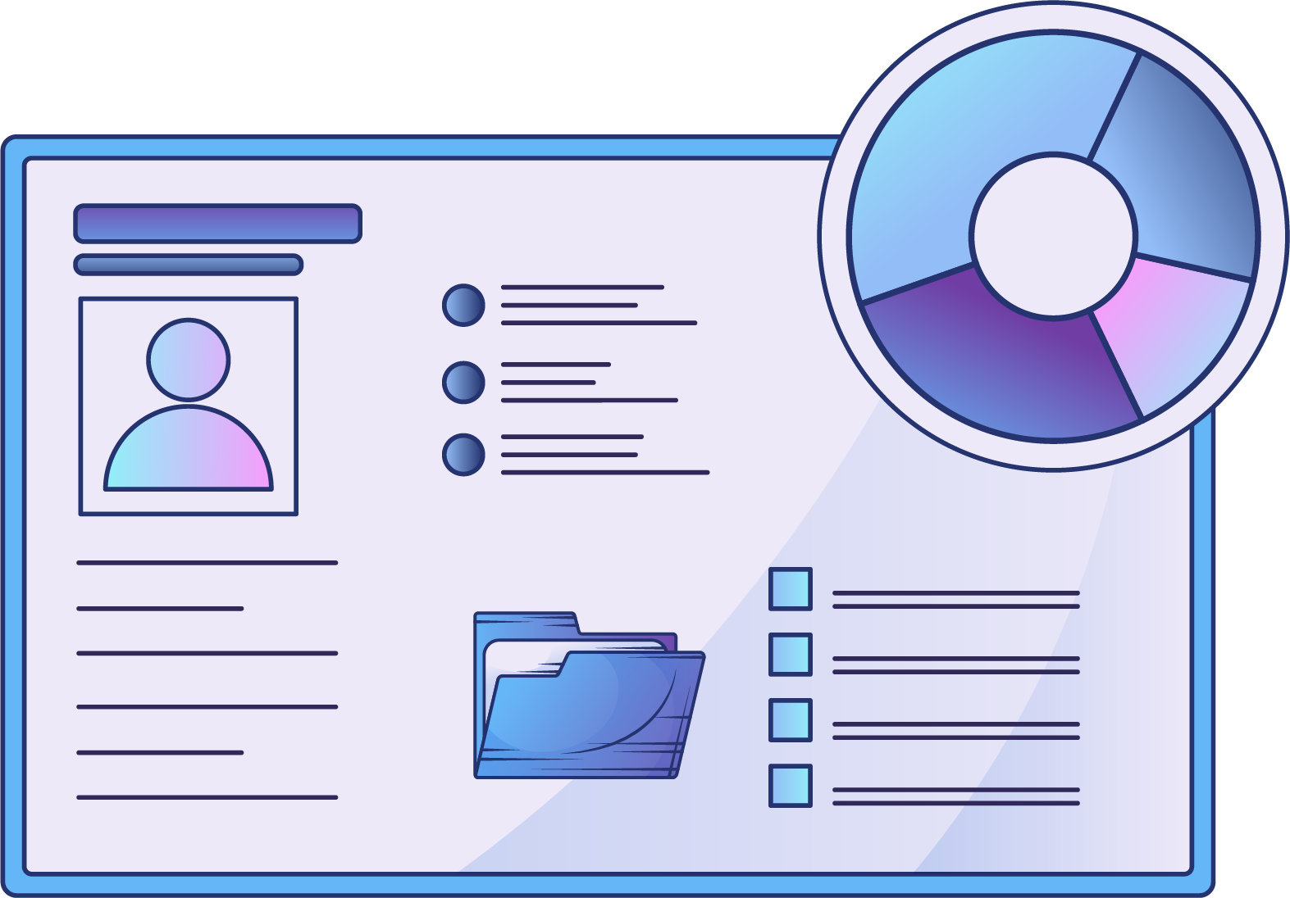
CYBER ETHICS
The moral principles that gain dynamics as per new issues raised by new technologies and regulate the use of are computer ethics
Computer ethics have proven to be important as they fulfil the above mentioned objectives and also avail ICT in the society, supress dishonest businesses alongside promoting fair competition, moral and social values

Slide 11
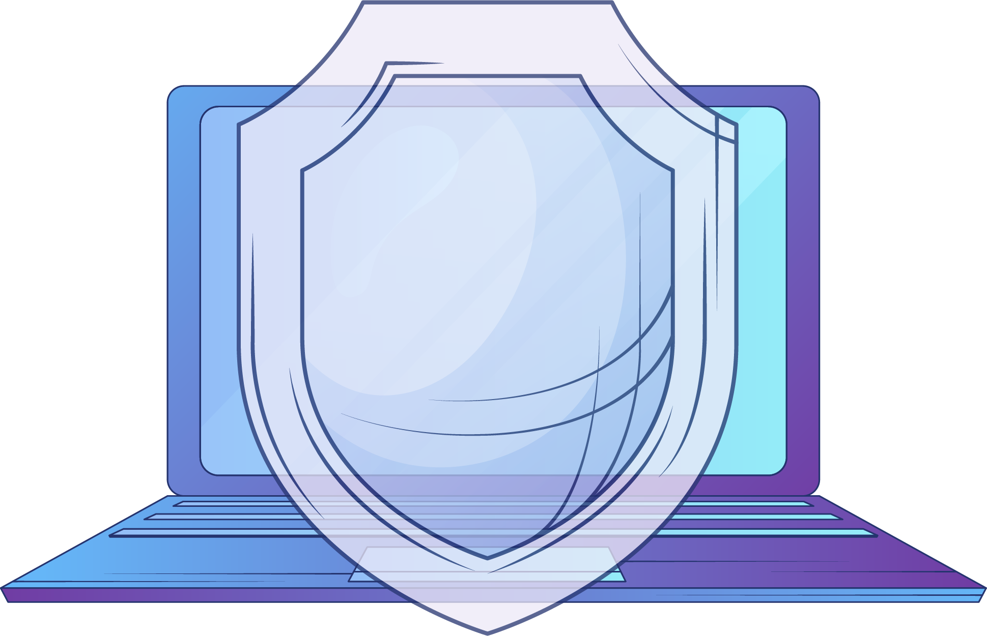

FIRST
CURRENT
SECOND
Telecommunication act of 2053 (1997) & Telecommunication Regulation of 2054 (1997)
Information
Communication
Policy 2072 (2015)
Information Technology Policy of 2057 (2000)

Slide 12



Thanks!
Do you have any questions?
PLEASE PUT FORWARD ANY SORT OF QUERIES
HAVE A GOOD DAY!

